Slide 1
El Niño and La Niña

Slide 2
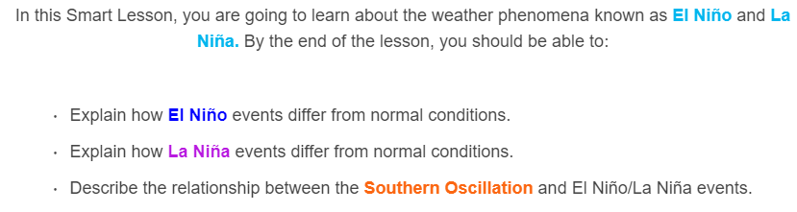
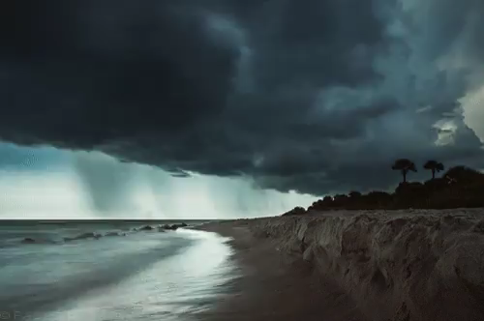

Slide 3


Slide 4
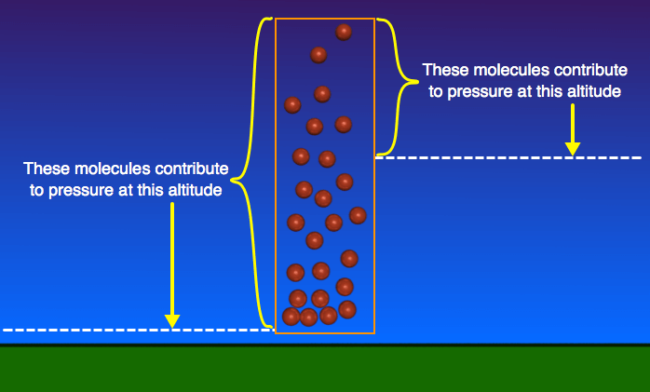
Atmospheric pressure is the weight of all the air above you.
This weight depends on the temperature, altitude and humidity of the air. On average, a one square meter column of air at sea level weighs about 10,000kg!
Fortunately, our bodies naturally push back against this weight so we aren't crushed!

Slide 5
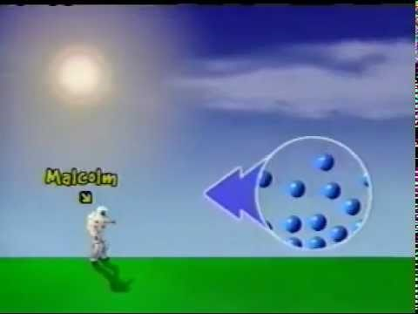

Slide 6
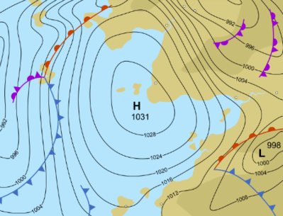
If you watch the weather forecast, you'll know that areas of high pressure (H) usually bring good weather and areas of low pressure (L) usually bring poor weather.

Slide 7
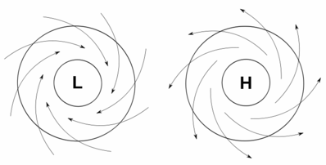
When there is low pressure, there isn't as much air pressing down as usual. As a result, air at ground level will flow inwards and upwards.
When there is high pressure, there is more air pressing down than usual. As a result, air at ground level will flow downwards and outwards.

Slide 8
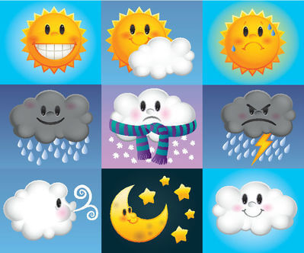
This means low pressures will pull warm, wet air upwards, where it cools and the moisture condenses as rain.
Meanwhile, high pressures will push cold, dry air downwards, resulting in clear, cloudless skies.
It may seem strange that cold air results in good weather, however cloudless skies mean less rain and more sun!

Slide 9
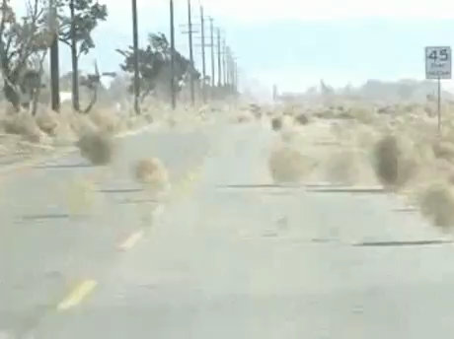
Atmospheric pressure also has a significant effect on wind conditions. Air flows from areas with high pressure to areas with low pressure.
The bigger the difference in pressure, the faster the air will flow and the stronger the winds will be.
Remember: wind is just the movement of air!

Slide 10
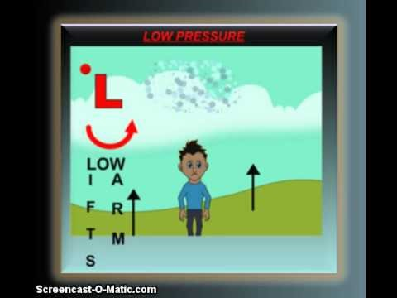

Slide 11

The El Niño-Southern Oscillation is an irregular, repeating variation in wind speeds and sea temperatures over the equatorial Pacific Ocean.
There are three stages to this oscillation:
La Niña events
'Normal' conditions
El Niño events

Slide 12
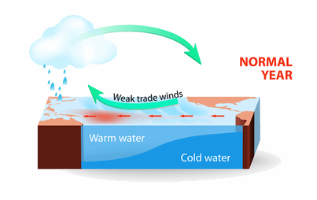
During normal conditions, currents and strong winds (known as trade winds) push warm water towards Australia.
The strength of the winds depends on the pressure difference between the east and west Pacific.

Slide 13

The warm water evaporates, producing warm, wet air. The warm air rises, where it cools and the moisture condenses as rain.
You may recognise this as a low pressure system.

Slide 14
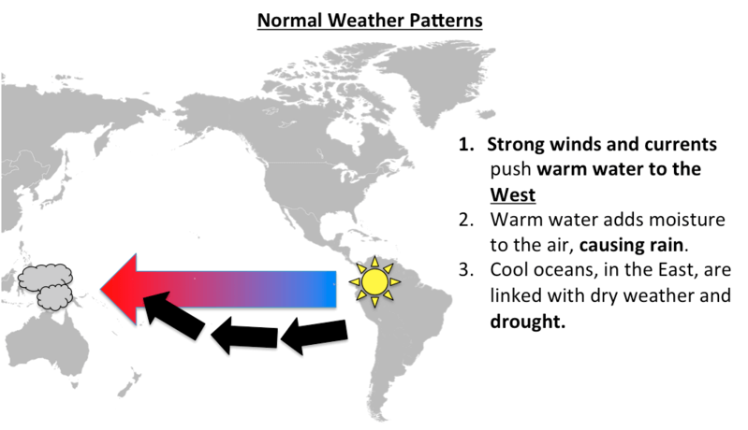
As this picture shows, during normal conditions, Australia experiences an average amount of rain due to the amount of moisture in the air.
Normal conditions are experienced roughly 50% of the time.

Slide 15

If you have difficulty remembering the difference between warm and cold air, think of it this way:
Warm air is wet.
Cold air is clear.
This is because warm air can hold more water than cold air!

Slide 16
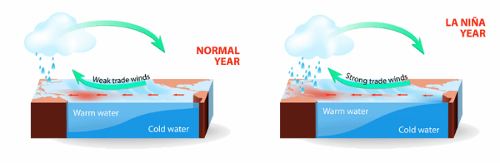
During La Niña events, the winds and currents are much stronger and the water that reaches Australia is even warmer.
When this occurs, there is a big pressure difference between the east and west Pacific.

Slide 17
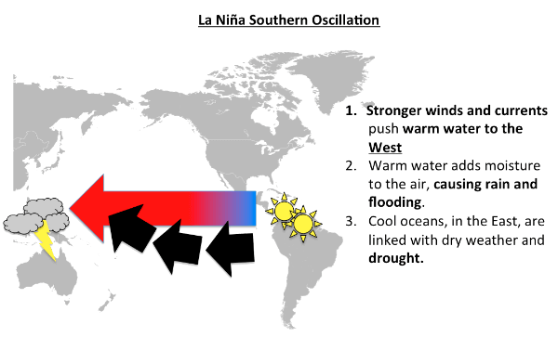
As this picture shows, during La Niña events, Australia will experience extreme rain and flooding, due to increased moisture in the air.

Slide 18
During La Niña events, South America receives much drier weather than usual.
This is because cold water is being pulled from deep underwater and is blown away before it has time to heat up.

Slide 19
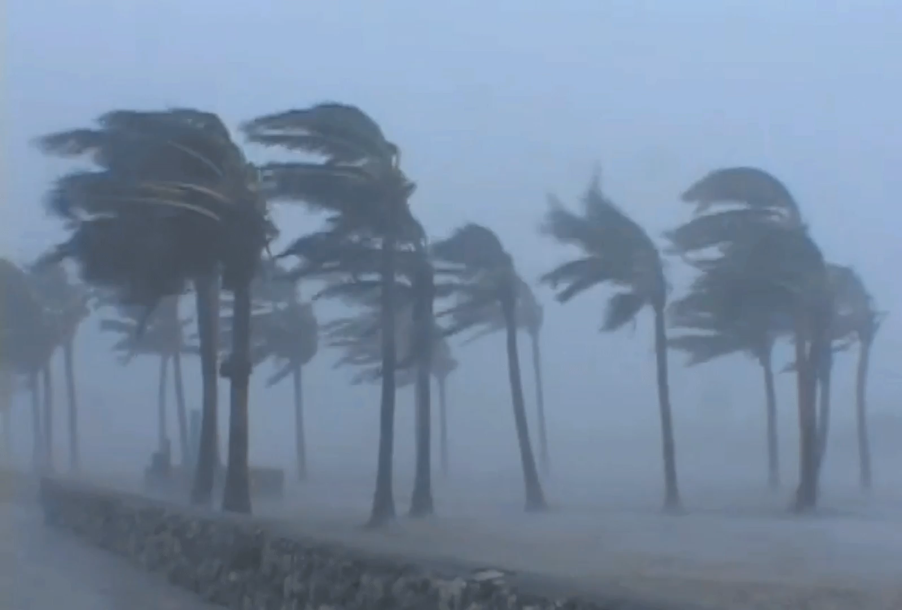
To summarise La Niña events:
1. | The difference in atmospheric pressure between the east and west Pacific is greater than usual.
2. | This causes the trade winds to blow stronger than usual, moving warm waters closer to Australia.
3. | Warm water evaporates, forming warm, wet air.
4. | The warm air rises and cools, and the moisture condenses as rainfall.

Slide 20
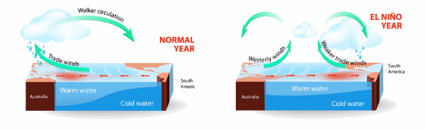
During El Niño events, the winds are much weaker and the warm water flows away from Australia.
When this occurs, there is very little pressure difference between the east and west Pacific.

Slide 21
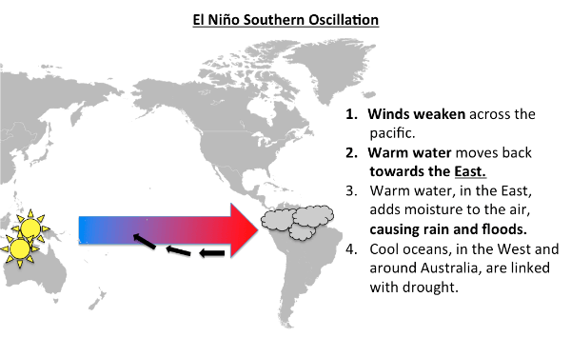
As this picture shows, during El Niño events, Australia will experience dry weather and droughts, due to the decreased moisture in the air.

Slide 22
During El Niño events, South America receives increased rainfall and flooding.
This is because the warm waters are moving closer to South America and increasing the moisture in the air.

Slide 23
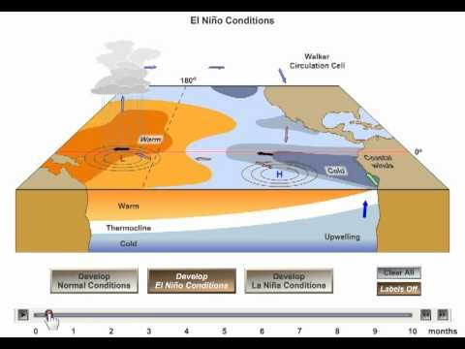

Slide 24
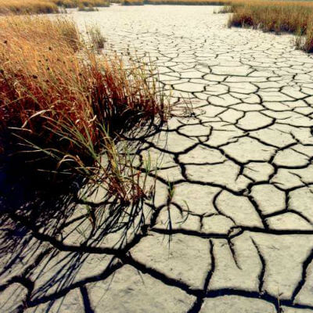
To summarise El Niño events:
1. | The difference in atmospheric pressure between the east and west Pacific is smaller than usual.
2. | This causes the trade winds to blow weaker than usual, moving warm waters further from Australia.
3. | Cooler water evaporates less than warm water, resulting in relatively cool, dry air.
4. | This dry air has little moisture and results in very little rainfall.

Slide 25
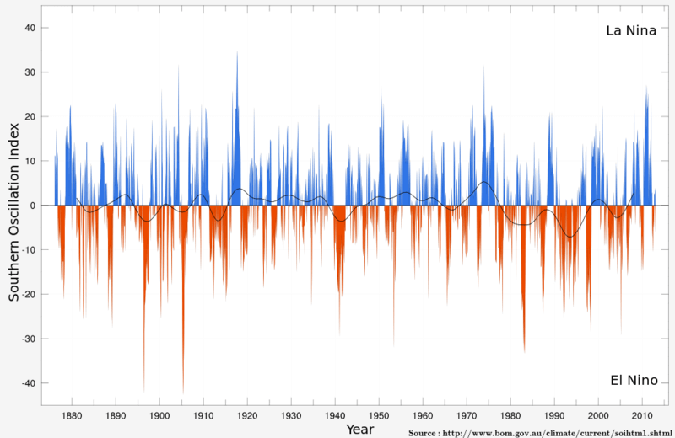
The southern oscillation describes the changes in atmospheric pressure above the equatorial Pacific Ocean.
These changes are a cycle, meaning that sometimes the pressure will be higher than average and sometimes it will be lower.

Slide 26
This graph shows the Southern Oscillation Index (SOI), which is a measure of the difference in air pressure between Tahiti (East Pacific) and Darwin (West Pacific).
The x-axis (horizontal line) represents the difference in air pressure during normal conditions.

Slide 27
When the difference in air pressure is higher than normal (positive SOI), there is a La Niña event.
When the difference in air pressure is lower than normal (negative SOI), there is an El Niño event.
Wind flows from high pressure to low pressure. The bigger the difference in pressure, the faster the wind will flow.

Slide 28
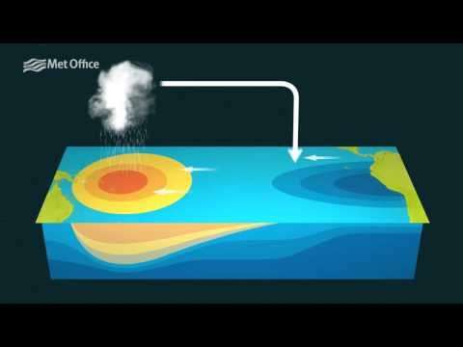

Slide 29

You may be wondering:
"If changes in atmospheric pressure cause the trade winds to increase/decrease in strength and these increases/decreases change the atmospheric pressure, what causes the whole process in the first place?"
The simple answer is scientists are still working that out!

